Slide 2
Partner notification & Treatment
Hannelore Götz
22 July 2018
Notes:
Hannelore Götz (Public Health Service of Rotterdam) w
ill provide an overview of best practices of
partner notification and (patient-initiated) partner
therapy, as well as different approaches within and
between countries. There will be discussion around the nee
d to strengthen partner notification with new
linkage models, (e.g., pharmacy-assisted partner therapy,
direct-access internet self-testing and partner
notification via email).

Slide 4
Outline presentation
PN Chlamydia trachomatis
Expedited Partner therapy EPT– Accelerated PT – Patient initiated PT
Implementation
HIV
Role of PN in HIV prevention
Recent results iPN
Provider notification
Take home messages
Notes:
In my presentation I will discuss the issues present in Chlamydia PN – Ct being the most common bacterial STI at our clinics and review some reports on Partnertherapy, and shortly touch on the results of our Picc UP study.
Internet PN will lead to the role of HIV PN in HIV prevention

Slide 5
Partner notification & therapy
Notes:
PN aims at preventing reinfection by an untreated partner (individual aim) and at interrupting further transmission.
Partners can be warned by the index patient personally, by phone, by a contactcard or sms/email.
Partner ought to be tested and treated if indicated.
Most of you will experience limited time for partnernotification for chlamydia and usually notification is left for the patient

Slide 6
Expedited Partner therapy
prescription
Notes:
In the US Expedited partner therapy is widely persmissible,
Partner treatment is provided without contact with the partner, either by handing out medication or a prescription for the partner to the index case.

Slide 7
EPT effectiveness
Reducing reinfection in index cases with curable STI’s ¹
EPT more effective than patient referral
Risk Ratio 0.71 (95% CI 0.56 – 0.89)
Enhanced patient referral
- Intensive counseling
- Booklets / infection specific website
- Test kit
no evidence EPT better than enhanced patient referral:
Risk Ratio 0.96 (95% CI 0.60 – 1.53)
1 RCT population prevalence decreased, non sign.²
¹ Ferreira A, et al Cochrane Database Syst Rev 2013; 10: CD002843;
Althaus, C., K. Turner, et al. (2014) Health Technol Assess 18(3): 1-100; ² Golden 2015 NEJM.
Notes:
A metaanalysis found that when looking at reduction of reinfection in index cases with curable STI’s
EPT was more effective than patient referral
They also looked at studies who used enhanced Partnernotification, where Intensive counseling was used, or booklets and information material in websites was provided, or where testkits were given to partners.
They found no evidence that EPT was better than enhanced patient referral.

Slide 8
Accelerated PT UK
prescription
% contactable partners treated
Routine PN 36% (42/117)
APT hotline 59% (80/135) p=0.003
APT pharmacy 66% (29/44) p=0.001
Preferences & recruitment rates varied between sites, staff satisfaction, approach to consent, characteristics local population
Estcourt 2012 Sex Transm Infect 88(1): 21-26
Notes:
Claudia Estcourts group is studying APT.
In APT the health care provider does seek contact with the partner – for example by phone, checks allergies and interactions, and the partner can get a prescription of collect medication at a pharmacy.
They fount a higher proportion of contactable partners treated with APT compared to routine PN, but also found that results varied much between clinic sites.

Slide 9
PICC – UP Patient initiated Partner therapy professionals
GP
Notes:
In our Picc Up study we combined interviews & questionnaires to assess the experiences and opinions of sexual health providers in the Netherlands, being GPs and STI clinics.
They agreed that partners of chlamydia patients should be treated but stressed that they wanted to counsel partners and not hand out medication without speaking to them.
When asked about the importance of partner treatment, 97% of respondents agreed that the current steady partner of an index patient should be treated immediately.
For the current casual partners this was lower; with 43%.
An outstanding difference is seen when looking at the answers at the question: would you give medication for the partner to the index patient?
For the steady partner, 51% agreed and would consider PIPT. For the current casual partner this was only 8%.

Slide 10
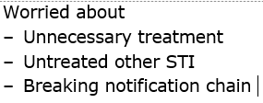
Patients and Partners
Partner notification different
Partner treatment
Prescription / pills

Slide 11
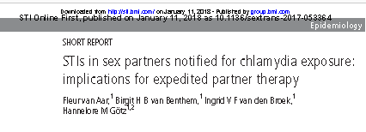
STI in patients notified for chlamydia
34% (4947/ 14,445) chlamydia positive
1.2% gonorrhoea
10.2% (174/1702) gonorrhoea cases - Missed if untested
Unnecessary treatment Chlamydia versus untreated
Potentially missed STI
Notes:
Results O f all consultations in 2015 (n=101 710),
14 445 (14.4%) clients reported to be notified exclusively
for chlamydia. Among chlamydia-notified clients, the
chlamydia positivity rate was 34.2% (n=4947), and
consequently 65.8% (n=9488) of them tested negative
for chlamydia. Chlamydia-notified clients contributed to
10.2% of all gonorrhoea infections (n=174/1702) and
10.9% of all infectious syphilis, HIV and/or infectious
hepatitis B infections (n=15/173).
Conclusion Implementing EPT without additional
STI testing for all partners of chlamydia-infected index
patients implies that STIs other than chlamydia will be
missed. Although the chlamydia positivity rate was high
among chlamydia-notified partners, two-thirds would
unnecessarily use azithromycin. An evaluation of EPT
against the current partner treatment strategy is needed
to carefully weigh the potential health gains against the
potential health losses and to explore the characteristics
of EPT-eligible partners.

Slide 12
Potential possibility PIPT in NL under current legal situation:
partner could receive medication directly via index
even if his identity is not known
personal contact by telephone / SMS / internet
informed consent, assessment of medication history
provision of diagnostic test
provision of written information about medicine
reporting in a medical file
Best possibilities at STI clinics at PHS
no support for large-scale introduction of EPT

Slide 13
Real world implementation
1076/1964 (55%) accepted EPT
No difference age /sex / race
246 / 492 (52%) EPT; Women >
323 treated & retested:
Reinfection 13% EPT vs 27%
2578 eligible for EPT
Requirement documentation:
EPT acceptance from 20% to 48% no significant reduced risk of chlamydial reinfection
Vaidya 2014 Sex Transm Dis 41(11): 690-694.; Taylor 2013 Int J STD AIDS 24(5): 371-374. Mickiewicz 2012 Sex Transm Dis 39(12): 923-929

Slide 14
Oliver
prescription
Oliver Sex Transm Dis 2016 43(11): 673-678.
Notes:
Oliver et al found in 421 women with CT that only 85% were treated. They were offered EPT for their partners, only 31% had EPT for any partner, and this was lower for the most recent partner
They compared EPT by medication and by prescription.
There was no significant difference in % partners treated, it was 75-80%. But here it is visible that the way via the pharmacy requires more steps whether the index or the partners goes to the pharmacy.

Slide 15
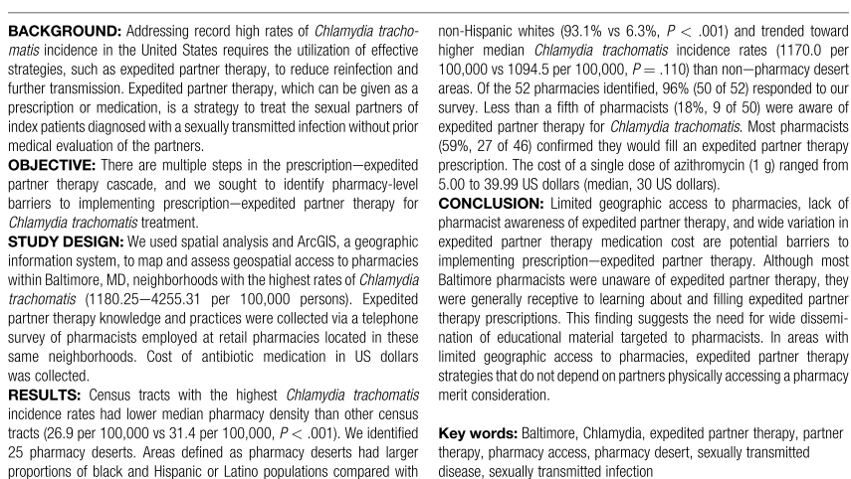
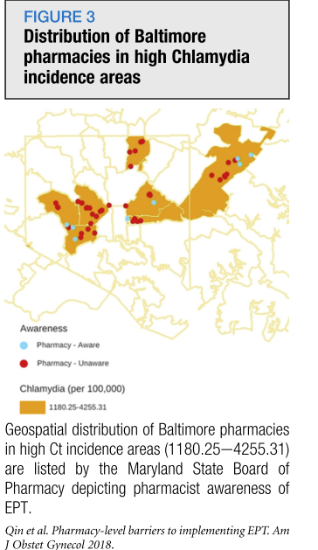
Qin
Qin J Obstet Gynecol 2018
Notes:
Pharmacy-level barriers to implementing expedited partner therapy in Baltimore, Maryland." Am J Obstet Gynecol 218(5): 504 e501-504 e506.
How does it work in the pharmacy.
In Baltimore it was found recently that less that a 5th of the pharmacists were aware of EPT. Especially in areas with high prevalence of Chlamydia (here in orange) many pharmacists were unaware of EPT possibilities (red dots).

Slide 16
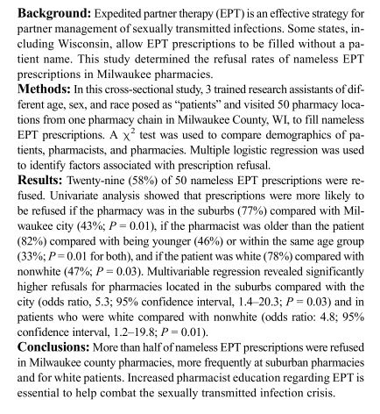
Borchardt
Borchardt Sex Transm Dis 2018 45(5): 350-353
Notes:
Borchart published this year that pharmacists refused EPT prescriptions in states where EPT was legalized.
Borchardt, L. N., M. L. Pickett, et al. (2018). "Expedited Partner Therapy: Pharmacist Refusal of Legal Prescriptions." Sex Transm Dis 45(5): 350-353.

Slide 17
Prescription EPT - > PT ?
Additional studies needed
Prescription EPT vs medication
Benefit cost analysis PH departments purchasing & distributing EPT
Washington ¹
California ²
Cost effective ³
RCT mimicking reality intervention
Danger providing EPT in form neither expedited nor PT
1 Golden Sex Transm Dis 2007, 2 Kovalevski 2016 Nat STD prev conf, 3 Gift Sex Transm Dis 2011 4 Schillinger Sex Transm Dis 2018
Notes:
The question can be raised like Julia schillinger did – whether providing EPT in this situation is still expedited and whether PT is achieved.
She calls for RCTs mimicking reality intervention and for benefit cost analysis in PH departments purchasing & distributing EPT

Slide 18
RCT APT
Will give answers on effect on individual level
https://www.lustrum.org.uk/information-for-healthcare-professionals.html
Notes:
The Lustrum group under CLaudia Estcourt is investigating partnership typologies and has started an RCT about APT in the UK.
This is most needed to see whether APT is effective in the circumstances of health care in UK ./ and could possibly be in other countries.

Slide 19
How chlamydia control
In the absence of systematic screening
Testing & Casemanagement
Counseling & Partnernotification
Patient referral at least current and last 2-3 partners
Selective cases PIPT
Special focus & resources on those
with potential of high transmission
repeat infection

Slide 20
HIV prevention – partner services
HIV testing included in STI testing
PLWH not in care
Referral for treatment
Partner notification
HIV negative
PREP
Partner testing
New HIV diagnosis
Re-link to care
Partner notification
Partner testing
Notes:
Let s now move to HIV Partner services.

Slide 21
Percentage new HIV pos / STI notification in Dutch STI clinics
NNTI 1984/93 = 21.3
Data SOAP (F. v Aar)
Notes:
% pos toevoegen

Slide 22
Distribution of new HIV cases in MSM by STI notification
Data SOAP (F. V Aar)

Slide 23
HIV & Syphilis PN in Dutch STI clinics
3 months period
456 diagnoses syphilis, 104 HIV, 18 both
56,5% valid registration PN
(MSM: n=286, vrouw: n=11 en hetero man: n=10)
PN indicated
PN possible
Patient referral
Provider referral
Acknowledgement Isabel Slurink RIVM

Slide 24
iPN internet partnernotification
Will iPN reach the hard to reach?
Case finding rates?

Slide 25
Low use of online PN sites
Rietmeijer, C. A., B. Westergaard, et al. (2011). "Evaluation of an online partner notification program." Sex Transm Dis 38(5): 359-364.
Kerani, R. P., M. Fleming, et al. (2011). "A randomized, controlled trial of inSPOT and patient-delivered partner therapy for gonorrhea and chlamydial infection among men who have sex with men." Sex Transm Dis 38(10): 941-946.
Plant, A., H. Rotblatt, et al. (2012). "Evaluation of inSPOTLA.org: an Internet partner notification service." Sex Transm Dis 39(5): 341-345.

Slide 26
Partnerwaarschuwing.nl (formerly suggest-a-test)
Provider makes code for specific STI
Indexpatient logs in
Sends notification by sms/email to partners
Allows also provider notification
Anonymous possible
(85% preference)
Or by name
Notes:
Blending website notification /centralized clinic based approach

Slide 27
Sender & receiver acceptability & usability of online PN tool 1
Rating of patients and partners: acceptable & usable
Less positive to notify/get notified for HIV than other STI’s
Majority patients chose anonymous notification (85%)
Partners found anonymous notification less acceptable than being notified by name
Anonymity less acceptable than the electronic delivery
80% patients reported they had notified more partners than without the website
1 van Rooijen et al. Sex Transm Dis 2018

Slide 28
HIV partner notification by internet
Source PN.nl website, acknowledgement H. Voeten

Slide 29
HIV partner notification by internet
Source PN.nl website, acknowledgement H. Voeten

Slide 30
HIV partner notification by internet
Source PN.nl website, acknowledgement H. Voeten
Notes:
Partners gewaarschuwd voor hiv: 410 in totaal door 92 indexen; 351 in 2017, 59 in 2018 (dus dit jaar relatief véél minder!) - 5 zijn per mail gewaarschuwd (=1,4%) in 2017, 1 per mail in 2018 (1,7%); de rest allemaal per sms - 16 ontvingen het met een naam erbij dus niet-anomiem in 2017 (4,6%); 11 in 2018 (18,6%); de rest anoniem - Homo-hetero verdeling: In 2017: 328 homo man (94,3%), 0 heteroman, 20 vrouw (5,7%). In 2018: 51 homo man (91,1%), 2 heteroman (3,6%), 3 vrouw (5,4%) (PS 3 missings in elk jaar) - 2017: 110 van de 351 hebben hun waarschuwing NIET bekeken, dat is 31% 2018: 22 van de 59 hebben hun waarschuwing NIET bekeken, dat is 37% GGD-RR: 2017: 9 partners hebben 33 mensen voor hiv gewaarschuwd. Van hen bekeken 8 hun waarschuwing NIET, dat is 24% 2018: 3 partners hebben 24 mensen voor hiv gewaarschuwd. Van hen bekeken 9 hun waarschuwing NIET, dat is 38%!

Slide 31
HIV partner notification by internet
110 (31%)
did not see notification
Online
Source PN.nl website, acknowledgement H. Voeten

Slide 32
iPN internet partnernotification HIV
Patients seek other ways
Even when used not enough in case of HIV
Including as adjunct to traditional partner services
Patient choice
Technique
Personal assistance choice
Patient referral
Nurse phone patient after a week
Contract referral
Provider referral:
After sending notification phoning partners

Slide 33
Patient referral versus Provider referral for HIV
Assisted partner services (PS) Kenya ¹
Immediate PS vs Delayed PS 6 weeks
Incidence rate ratio
Increase partner testing
4.8 (95% CI 3.7 - 6.4)
Testing 1st time
14.8 (95% CI 5.4 - 41)
New HIV diagnosis
5.0 (95% CI 3.2 – 7.9)
Enrolment into care
4.4 (95% CI 2.6 – 7.4)
Scaling up immediate PN approach
1 Cherutich LANCET HIV 2016

Slide 34
How to effectively reach partners for HIV PN
Provider referral
- more effective
- patient choice
Listen to the PLWH
- issues like stigma / discrimination
- Trust
Repeatedly & Active follow up
Combine efforts of several providers
- GP/ STI clinic / HIV treatment center
Peer support
HIV
GP
STi

Slide 35
Take home message
Chlamydia PN
Main aim at individual level: - reduction of reinfection
Population level prevalence ↓?
EPT / APT trials testing implementation in real life
Patient referral & focus on those with repeated infection
Internet PN where possible
HIV PN
Aim finding new cases
Especially in acute infection
High priority
Treatment possible
reaching U=U
Combined efforts of health care providers, peers and use combined methods
iPN, provider referral, active follow up patient referral

Slide 36
PREVENT

Slide 37
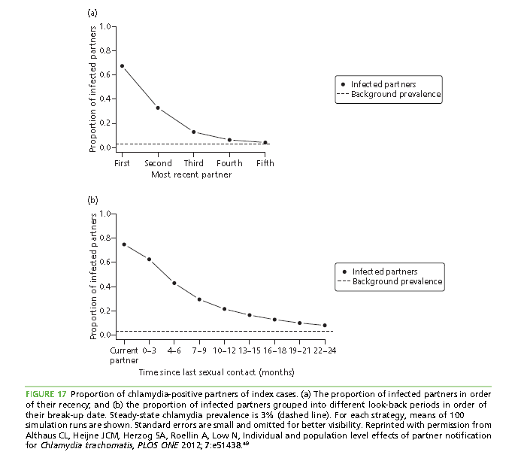
Modelling Partner notification chlamydia
INDIVIDUAL LEVEL
Per partnership transmissibility 55.5%
Per sex act 9.5%
67% of recent partners infected
Type of partnership
POPULATION LEVEL
Prevent onward transmission
Reduce overall prevalence
Screening PLUS PN
Strongest effect of PN current or most recent partner
Althaus, C., K. Turner, et al. (2014) Health Technol Assess 18(3): 1-100.
Notes:
Christian Althaus & colleagues did modelling on Chlamydia partnernotification. They assumed based on population studies that 67% of recent partners were infected.
They evaluated the proportion of infected partners in order of their recency and the proportion of infected partners into different look back periods.
When looking at individual effects of PN – finding new cases who can be treated - they found that notifying up to three recent partners would find a Ct infection rate still far above the prevalence of 3 %.
The same effect would be achieved when tracing as far back as 18 months.
In international guidelines a look back period for 6 months is advised. This gives a much higher positivity in Partners – and probably also a higher feasibility.
The aim of PN at population level is to Prevent onward transmission & Reduce overall prevalence.
They found that the strongest effect on population effect was found by notiying the most recent partner.
So how should we go forward with CT notification.
If we just treat the current partner – would it not be done?

